Slide 1
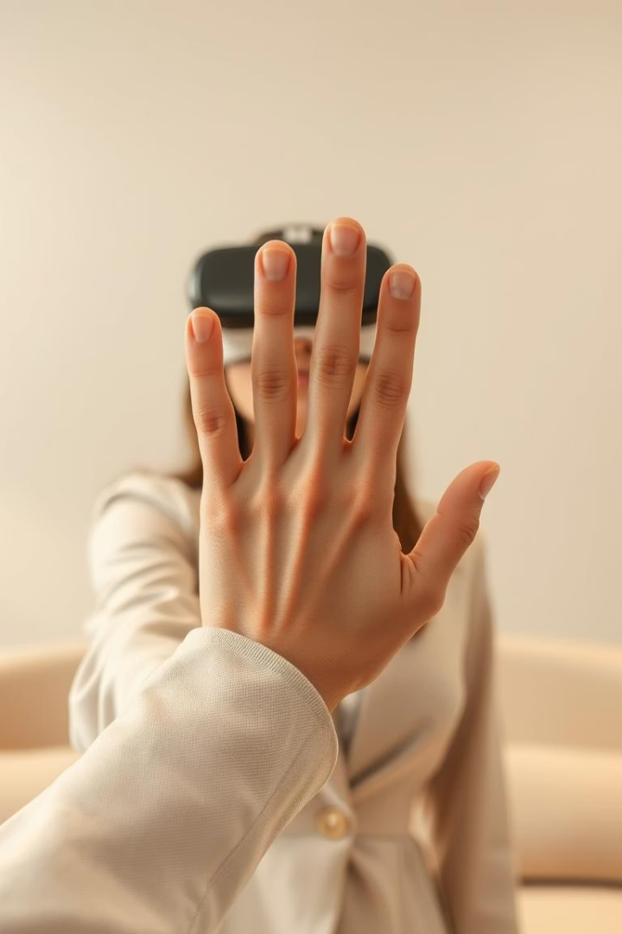
Occlusion-Robust Static Hand Gesture Recognition
Using Hybrid CNN + Transformer Model
Authors: Wasif Khan, Saif Alam Shaan, Sharif Mohammad Omar Faruq
Group: 07
CSE463: Computer Vision
Section: 01 BRAC University

Slide 2

Background and Challenges
Gesture Types & Occlusion Issues
Static Gestures: Fixed poses (e.g., rock, paper, scissors)
Dynamic Gestures: Motion-based (e.g., waving, pointing)
Occlusion Challenges:
Hands/fingers often hidden in VR
Vision systems struggle with occlusion & cluttered backgrounds

Slide 3
Motivation
Hand gestures enhance natural interaction in VR.
Static gestures like "rock", "paper", "scissors" are common.
Occlusion (e.g., hands behind controllers) is a major challenge.
Goal: Build an occlusion-robust, lightweight system for edge devices.

Slide 4
Problem Statement
Existing methods fail with partial hand visibility.
MediaPipe struggles with missing landmarks under occlusion.
Traditional CNNs lack global context understanding.
Need a model that combines local and global feature learning.

Slide 5
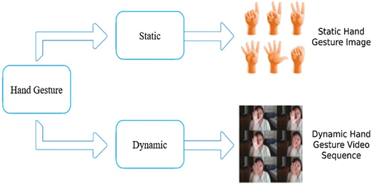
Gesture Types
Static Gestures: Fixed poses from single frames.
Dynamic Gestures: Require motion over time.
Focus of this work: Static gesture classification under occlusion.

Slide 6
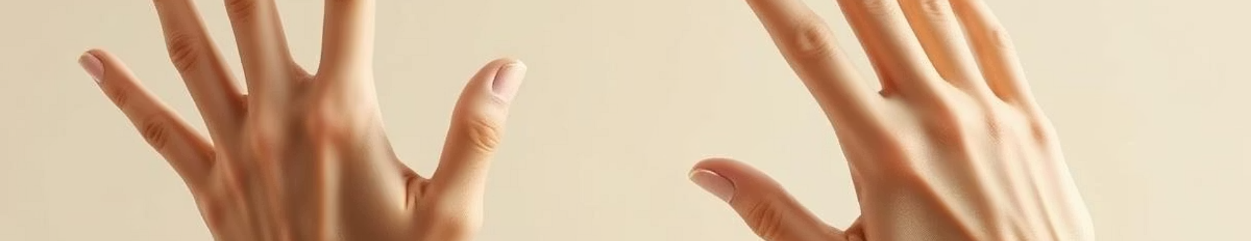
Dataset and Preprocessing
Data Fusion
Occlusion Augmentation
RGB-D Fusion
Combined MediaPipe Rock-Paper-Scissors and 2000 Hand Gesture datasets.
Artificial occlusions added by overlaying colored patches on RGB images.
Depth masks generated and merged with RGB channels for 4-channel input.

Slide 7
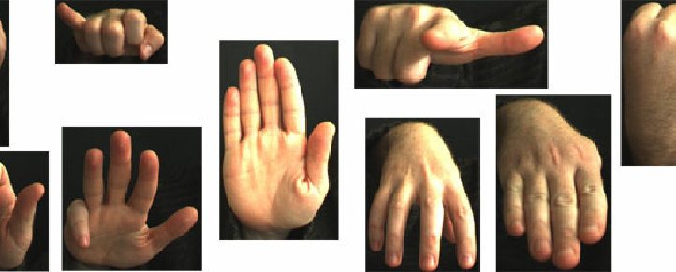
Datasets Used
MediaPipe Rock–Paper–Scissors dataset
2000 Hand Gesture dataset from Kaggle
Combined and labeled into 5 target classes:
rock, paper, scissors, fingerCircle, singleFingerBend

Slide 8
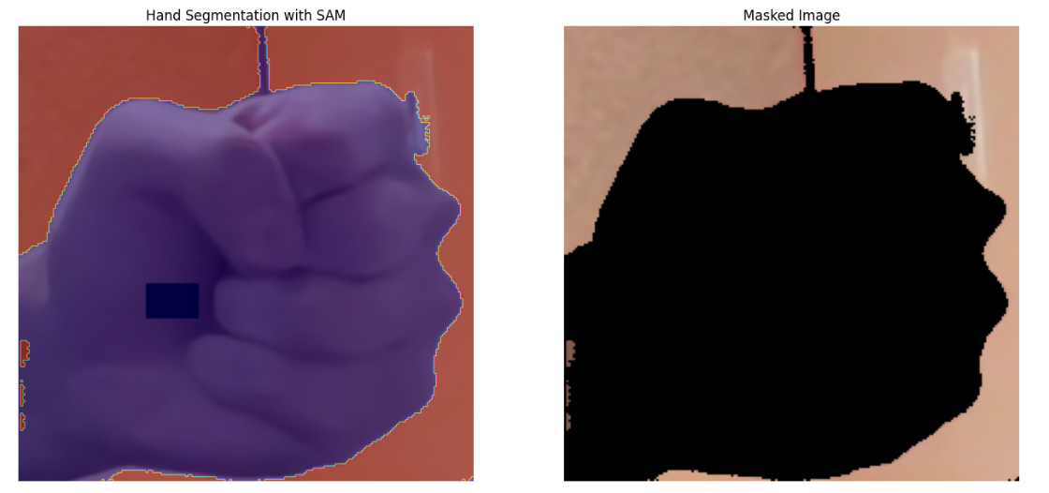
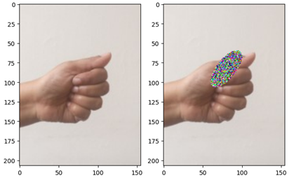
Data Augmentation &
RGB-D Fusion
Used SAM (Segment Anything Model) to generate binary hand masks.
Simulated occlusions by overlaying random colored patches.
Fused RGB with pseudo-depth → 4-channel (RGB-D) input.
Final input shape: (207 × 207 × 4)

Slide 9
Preprocessing & Labeling
Normalized RGB to [0,1], depth kept as is.
Labels encoded as integers for classification.
Dataset split: 70% train, 20% validation, 10% test.
Balanced classes using stratified sampling.

Slide 10

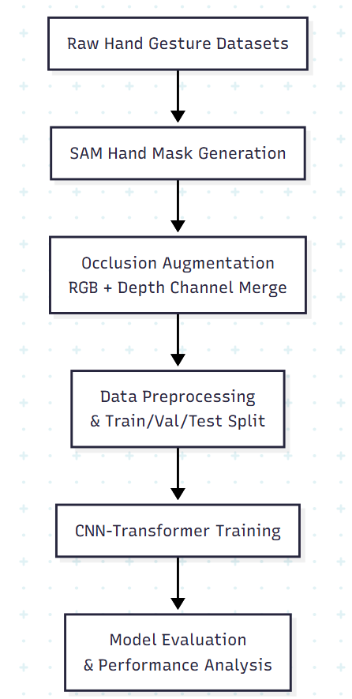
Model Architecture
Hybrid CNN + Transformer model:
CNN: Extracts spatial features.
Transformer: Captures global hand shape context.
Output: 5-class softmax classifier.
Input resized to 207×207, processed into 4x4 patches for Transformer tokens.
Baseline Models
Compared with:
ResNet-18 (modified for 4-channel input)
VGG-16 (also adapted for RGB-D)
Same output structure for fair comparison.

Slide 11
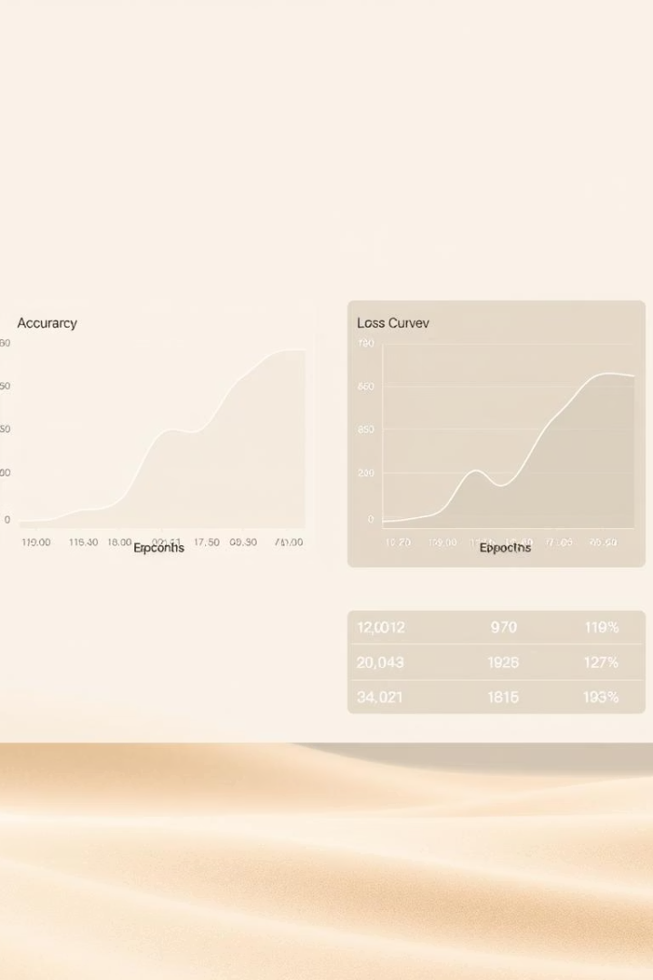
Training and Evaluation
1
Training Setup
2
Data Splits
Adam optimizer, learning rate 0.001, 30 epochs, batch size 32.
70% training, 20% validation, 10% test with stratified sampling.
3
Metrics
Accuracy, precision, recall, F1-score, and confusion matrix analyzed.

Slide 12
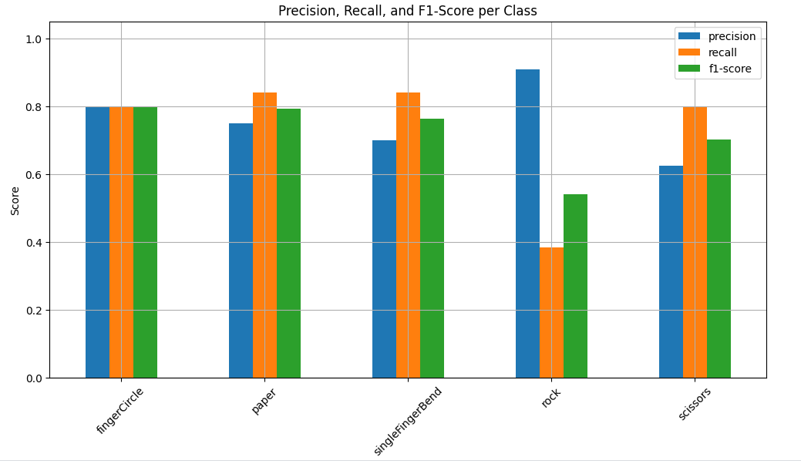
Results
Test Accuracy:
Hybrid model: 73.02%
VGG-16: 19.84%
ResNet-50: 9.52%
Confusion matrix shows:
Strong per-class accuracy
Minimal misclassifications even under occlusion

Slide 13
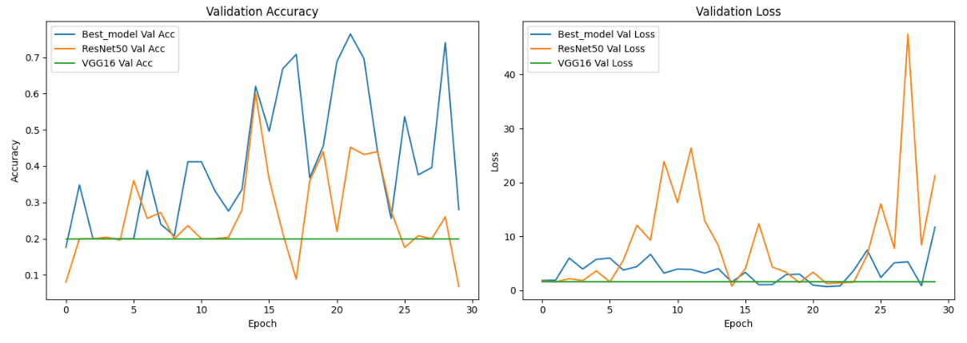
Performance Results
Test Accuracy
Training Peak
Robust Classification
Hybrid model achieved 73.02%, outperforming ResNet50 (19.84%) and VGG16 (9.52%).
Training accuracy peaked at 94.36% on validation set at 30 epochs. Accuracy 76.40% on test set.
Confusion matrix shows strong recognition across all five gesture classes.

Slide 14
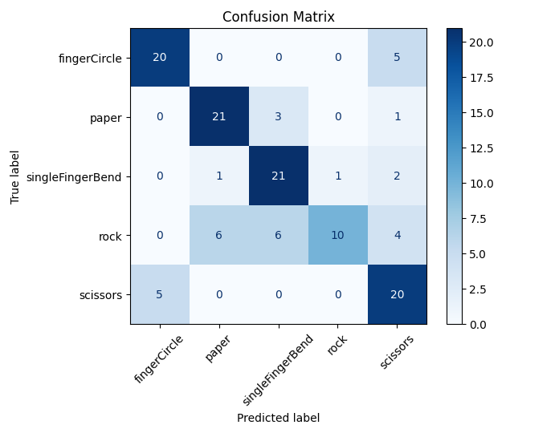
Confusion Matrix Insights
High Precision
Diagonal dominance indicates accurate classification per gesture class.
Low Misclassification
Minimal off-diagonal errors, even under heavy occlusion conditions.

Slide 15
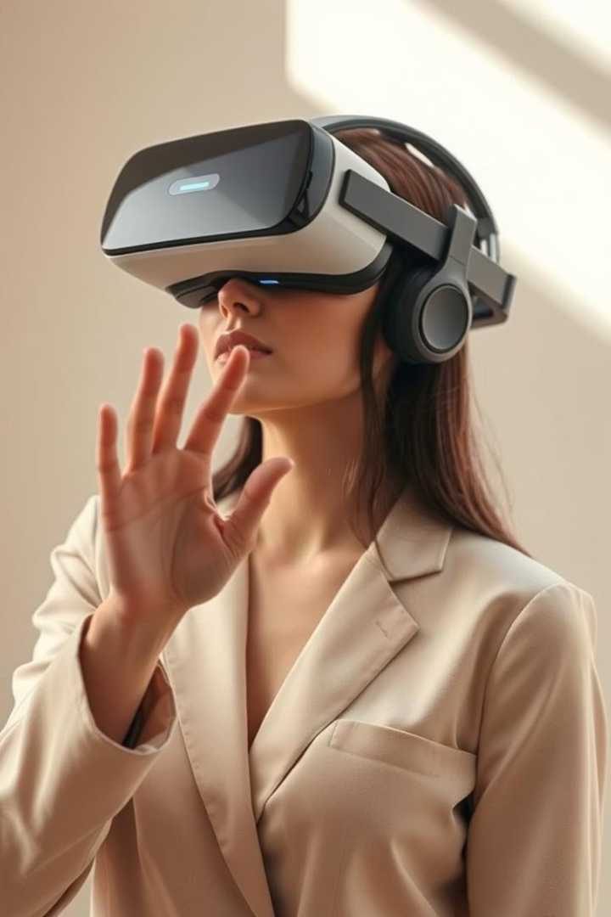
Conclusions and Future Work
Summary
Limitations
Hybrid CNN+Transformer model achieves ~74% accuracy with occlusion robustness.
Does not address dynamic gestures or extreme occlusions like full palm cover.
Future Directions
Extend to dynamic gestures, optimize for smartphone GPUs, deploy on VR headsets.

Slide 16
Code :
Augmentation: https://drive.google.com/file/d/11VeeQRVmW_kS4ZHtwPlyO9_XshOg48q1/view?usp=drive_link
Model Training and Results: https://drive.google.com/file/d/1AB9Dc50HiE-vFNtJE4BD8EHPBDpQzDlq/view?usp=sharing
Dataset: MediaPipe RPS: https://ai.google.dev/edge/api/mediapipe/python/mediapipe_model_maker/gesture_recognizer/Dataset 2000 Hand Gesture Dataset: https://www.kaggle.com/datasets/ritikagiridhar/2000-hand-gestures
Full Drive Link: https://drive.google.com/drive/folders/1mXbe0FUwWmbYnfnmSR0Rr0_qKtMzlW52?usp=drive_link
Full Project link: https://drive.google.com/drive/folders/1q8Sr9fv26hXeOJaLDvGheAmm-1iFrAUN?usp=sharing

